Slide 1

RxFiles ABX
Academic Detailing
Taking Antimicrobial Stewardship
to the Streets
Western Canadian One Health
Antimicrobial Stewardship Conference
Loren Regier BSP BA
RxFiles Academic Detailing
January, 2019

Slide 2
COI / Disclosures
Loren Regier
RxFiles Academic Detailing Service receives grant funding from the Saskatchewan MOH for academic detailing in SK and not-for-profit revenue from sale of printed and digital drug therapy resources. The Centre for Effective Practice (CEP) Academic Detailing Service receives grant funding from the Ontario MOH for academic detailing in Ontario.
Facilitator for educational outreach training / development for various groups such as National Resource Center for Academic Detailing (NaRCAD), Harvard Medical School, and the Canadian Academic Detailing Collaboration (CADC)
Contract work for CADTH on Evidence and Knowledge Mobilization
Pharmacist member - National Faculty, Opioid Guidelines in CNCP
No funding from the pharmaceutical industry

Slide 3
We know some of the challenges.
We’ve got information that can help.
How do we get it to providers
so change can happen?
L Regier

Slide 4
Outline
The story of what we did (& do)
Prep work
  Identifying gaps, needs and wishes
  Topic preparation & material development
Training the Detailers
  The topic & the method
The streets
  Talking with, and supporting providers
  Making it easier to do the right thing
  Impact

Slide 5
Prep work
Identifying gaps, needs & wishes
Take a look at the literature and see where the evidence leads
Hear from clinicians in practice
  What are they wrestling with?
  What are they doing?
  What do they want to know?
Check in with other best practice groups
L Regier

Slide 6
Prep Work
Topic prep & material development
Evidence
  Systematic Reviews & related RCTs
  CADTH
  Other info, including local antibiograms, etc.
Guideline & Stewardship Groups
  Regina & Saskatoon Antimicrobial Stewardship
  Bugs and Drugs
  MUMs – PAACT
  Choosing Wisely, etc.
L Regier

Slide 7
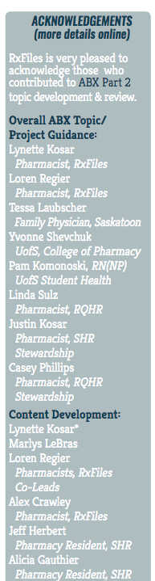
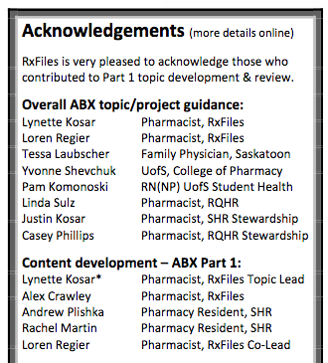
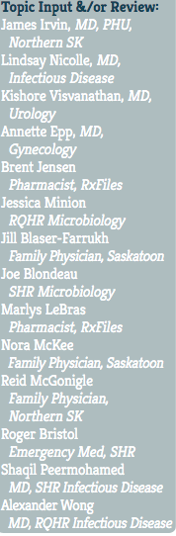
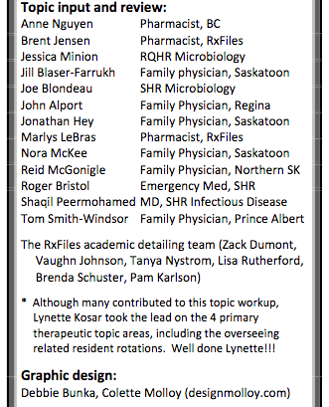
Prep work: Who’s involved?
ABX - 1&2
L Regier

Slide 8
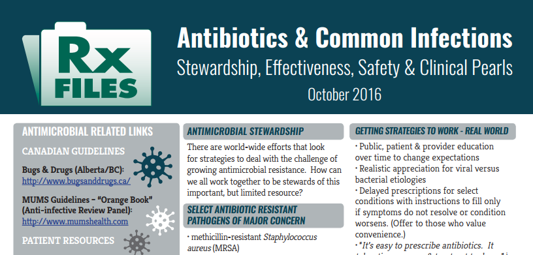
ABX-1
Antibiotic Stewardship
Common Infections
  Bronchitis, Acute
  CAP
  Pharyngitis
  Sinusitis, Acute
L Regier

Slide 9
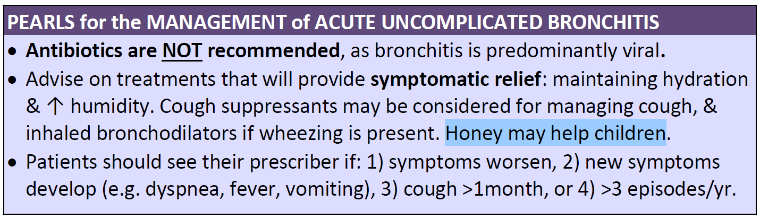
Acute Uncomplicated Bronchitis
L Regier

Slide 10
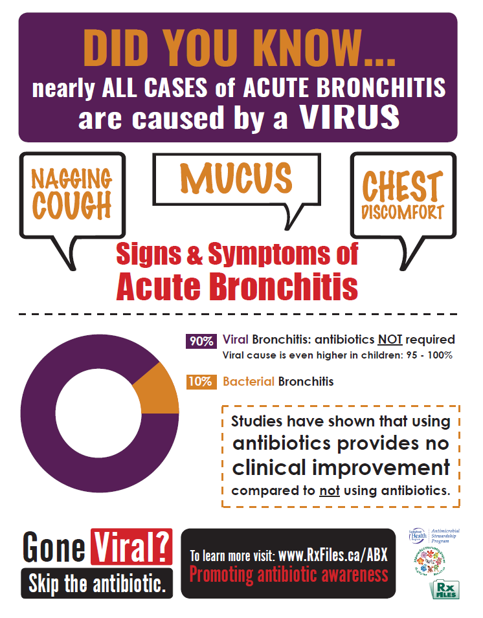
L Regier
Notes:
Up to 90% of acute bronchitis cases in adults are viral, & 95-100% in children.
Antibiotics are NOT recommended for acute bronchitis, as studies which have compared antibiotics to placebo have failed to show a benefit. Yet, in the United States, up to 80% of adults still receive an antibiotic.

Slide 11
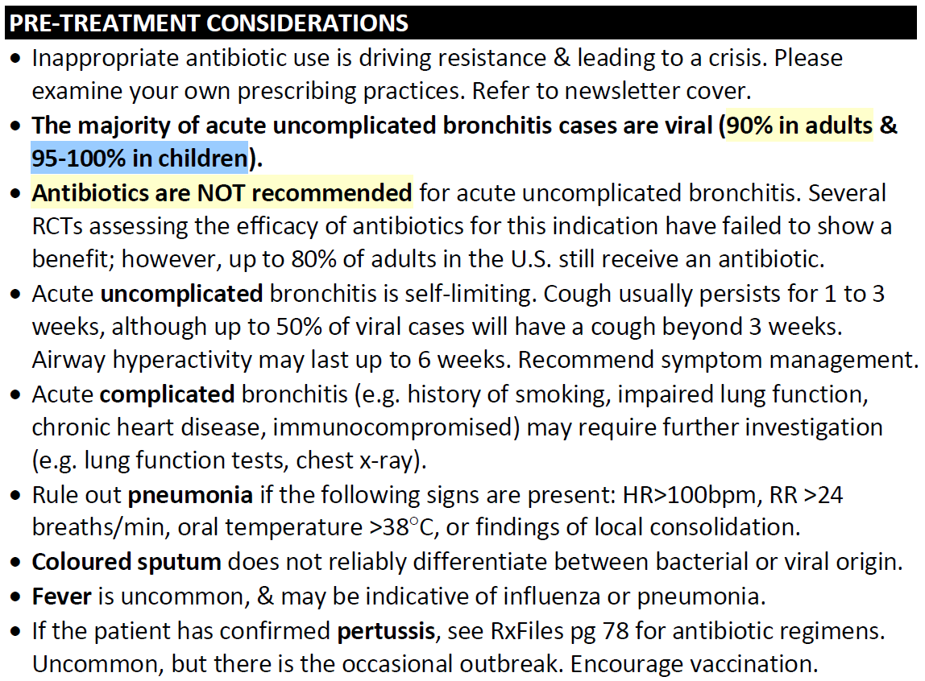
Acute Uncomplicated Bronchitis
Notes:
Preface that our document focuses on the management of acute UNCOMPLICATED bronchitis.
Define complicated; prescriber to rule out pneumonia. As a pharmacist, can ask about fever.
Coloured sputum indicates there is an infection, but does not differentiate between bacterial or viral origin. Only consider for AECOPD.
Cough will persist for weeks.

Slide 12
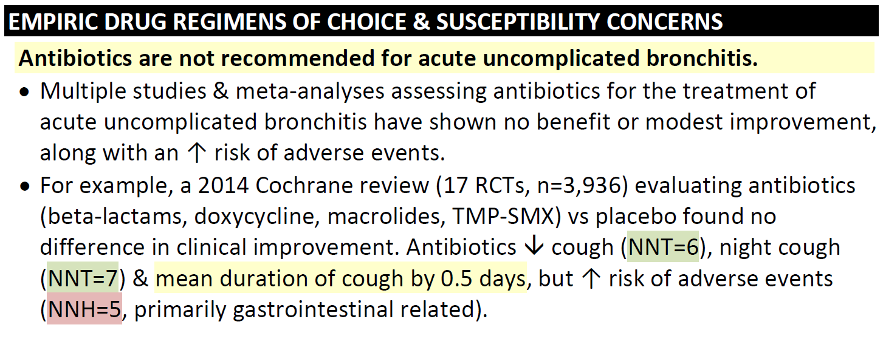
Acute Uncomplicated Bronchitis
L Regier

Slide 13
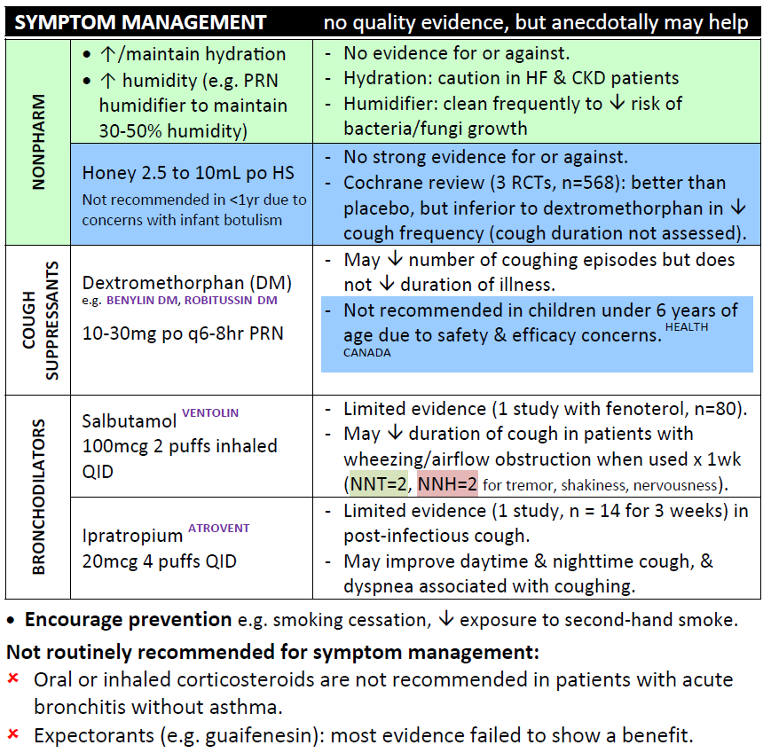
Acute Uncomplicated Bronchitis
L Regier
Notes:
Codeine syrup or tablets for nighttime cough

Slide 14
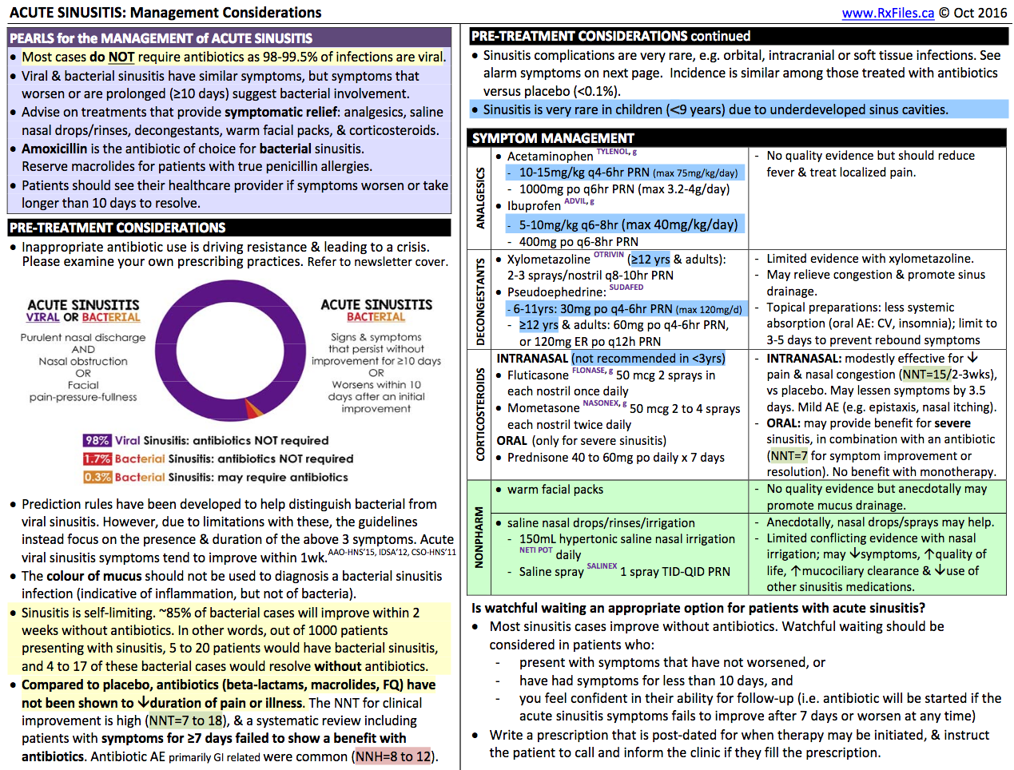
Acute Sinusitis
Is watchful waiting an appropriate option…?
  In patients who…
Write a prescription that is post-dated…
L Regier

Slide 15
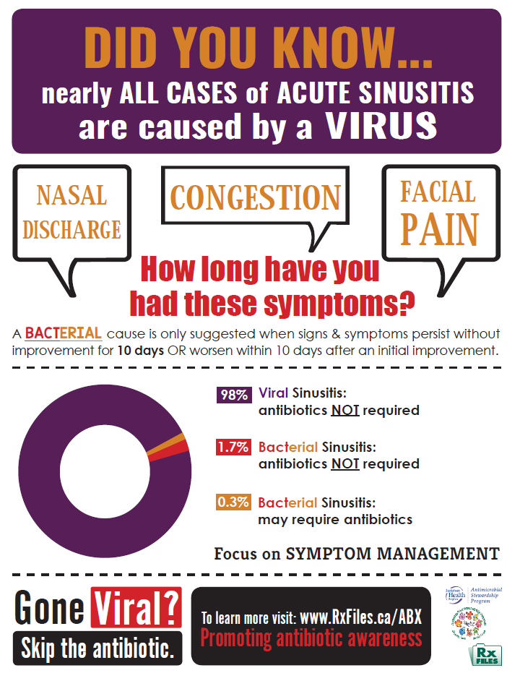
L Regier

Slide 16
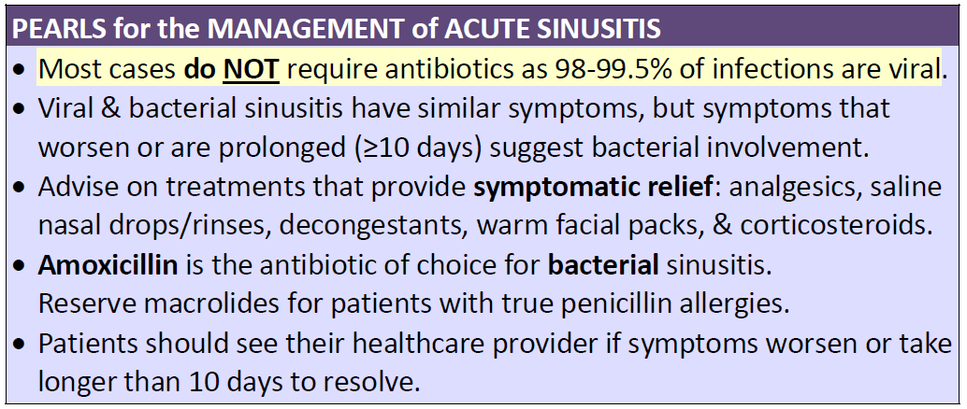

Slide 17
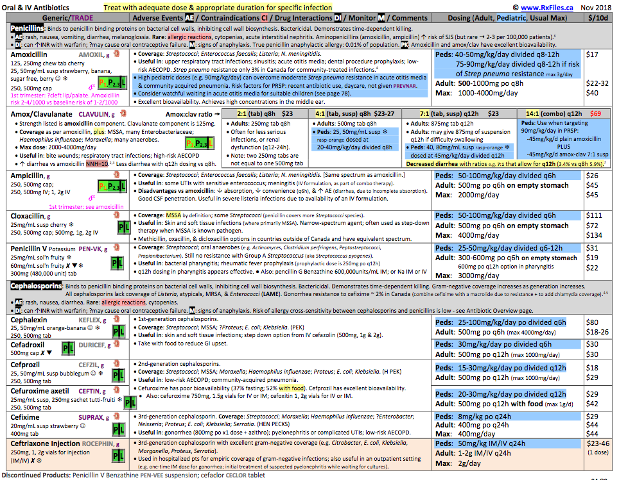

Supporting Clinical Tools
ABX
  Strength/form
AEs
CIs
DIs
Monitoring
Dosing
Cost
www.RxFiles.ca/abx
https://www.rxfiles.ca/rxfiles/uploads/documents/RxFiles-ABX-Public.htm
L Regier

Slide 18
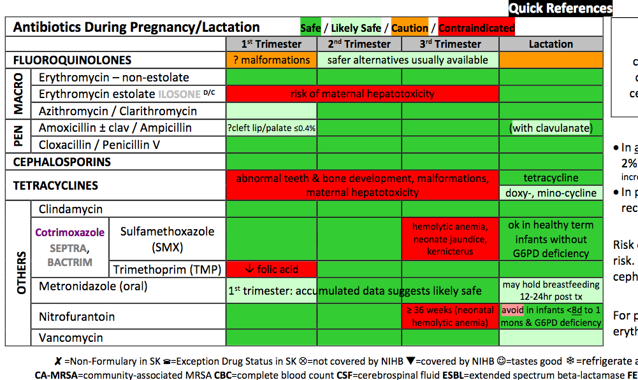
Supporting Clinical Tools

Slide 19
Barriers
”But…
  Patients expect an antibiotic
  It takes 10 minutes to explain, and 30 seconds to write a prescription
  They write nasty reviews online
  If they spend 2-3 hours driving here & waiting…
L Regier

Slide 20
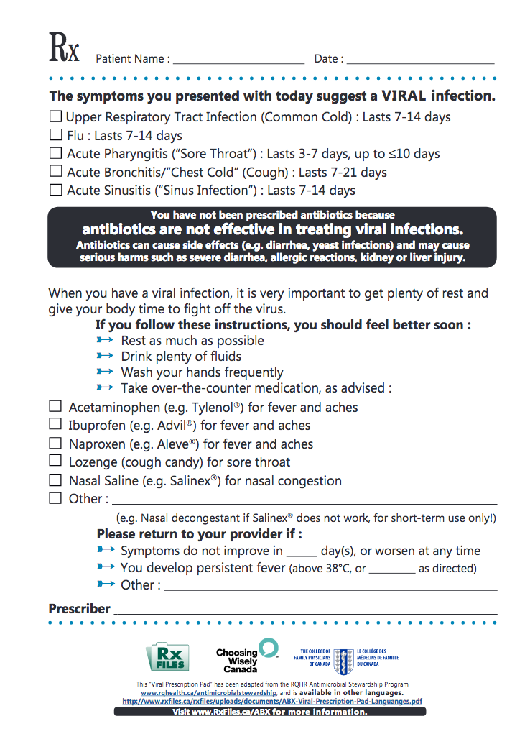
Supporting Patient Tools
Enablers
Viral Rx
Give something
Provides detail
Time saver
Reinforcer
Consistency across prescribers

Slide 21
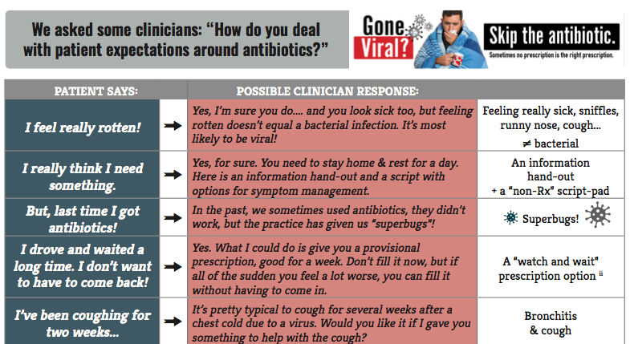
Supporting Patient Tools
Scripting Ideas for Clinicians
https://www.rxfiles.ca/rxfiles/uploads/documents/ABX-Newsletter-2016-COMPLETE.pdf

Slide 22
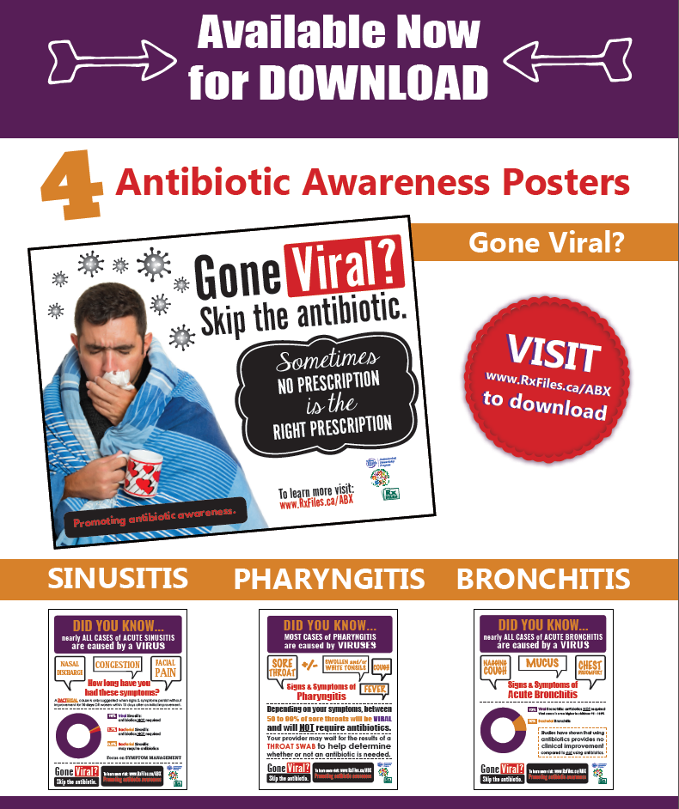
Supporting Patient Tools
Enablers
Clinic Posters
Prepare patient for discussion
Convey message
Reinforce message

Slide 23
Anecdote
L Regier

Slide 24
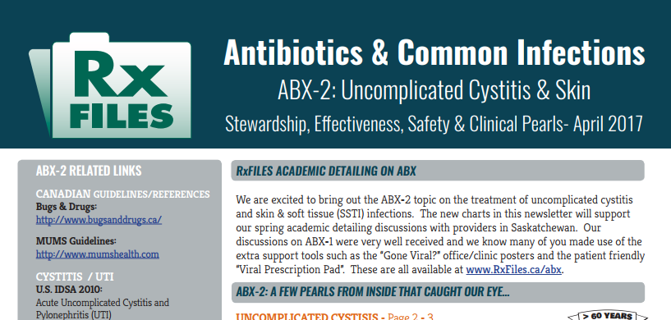
ABX-2
Common Infections -2
  Uncomplicated Cystitis
  Skin & Soft Tissue

Slide 25

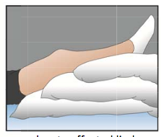
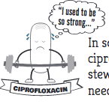
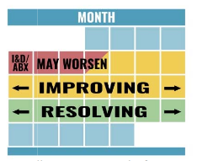
ABX-2
Take a Guess - Game Show

Slide 26
Training Detailers
The topic & the method
~6 wks: in the loop on topic development reading package
~4 wks: upskilling webinars
  local environment prep/networking
~1 wk: key messages:
FBBE (features, benefits, barriers enablers)
L Regier

Slide 27
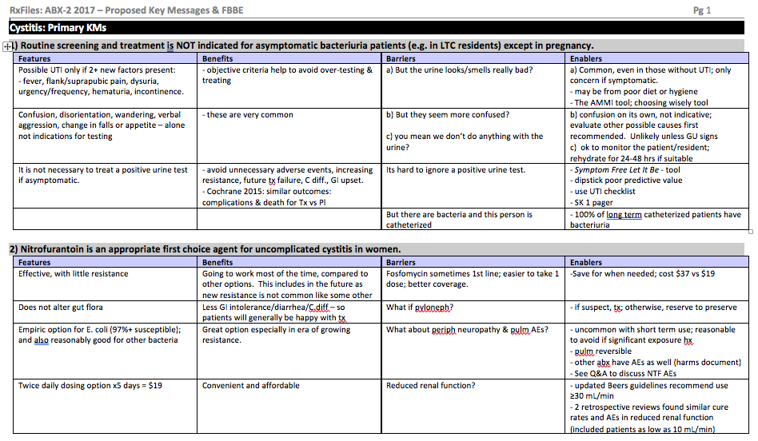
Key Message Homework Example
Features/Benefits/Barriers/Enablers
L Regier

Slide 28
Training the Detailers
The topic & the method
In-person training: 1-2 days
  Talk through key areas of the newsletter
    Certainties and uncertainties
    Various perspectives
    Minefields
  Entertain guest clinicians
    Family physicians
    Specialists
  Practice detailing – observed role plays
    Key message areas and complete visit

Slide 29
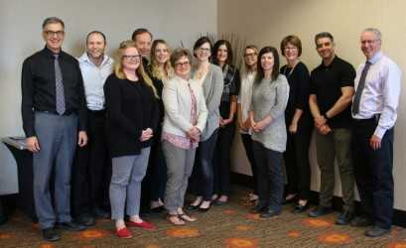
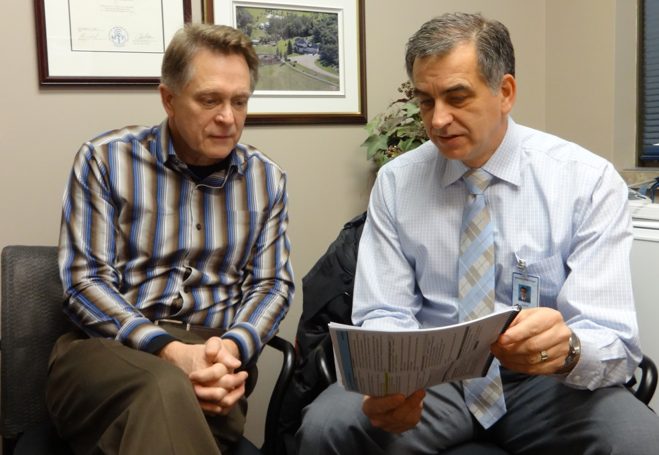
Training for the detailing visit
L Regier

Slide 30

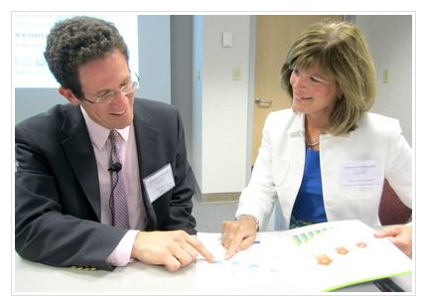

Academic Detailing
Basic Training
North America
Regular training workshops
2 or more times per year.
North American Resource Center for Academic Detailing (Boston)
https://www.narcad.org/training-series.html
L Regier

Slide 31

Academic Detailing
Basic Training
CADC (Canada)
Occasional workshops
in Canada
RxFiles Academic Detailing - College of Pharmacy and Nutrition,
University of Saskatchewan c/o 104 Clinic Place, Saskatoon, SK, S7N 2Z4
FAX: (306) 655-7980 Email: Loren.RxFiles@usask.ca

Slide 32
The streets
Talking with, & supporting, providers
300+ prescriber visits / topic
  In person conversations
1600+ newsletters mailed
100+ pharmacy grand rounds webinar
Social Marketing…
L Regier

Slide 33
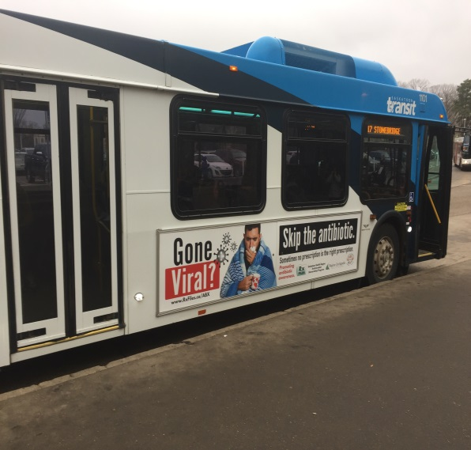

The streets
Social Marketing

Slide 34
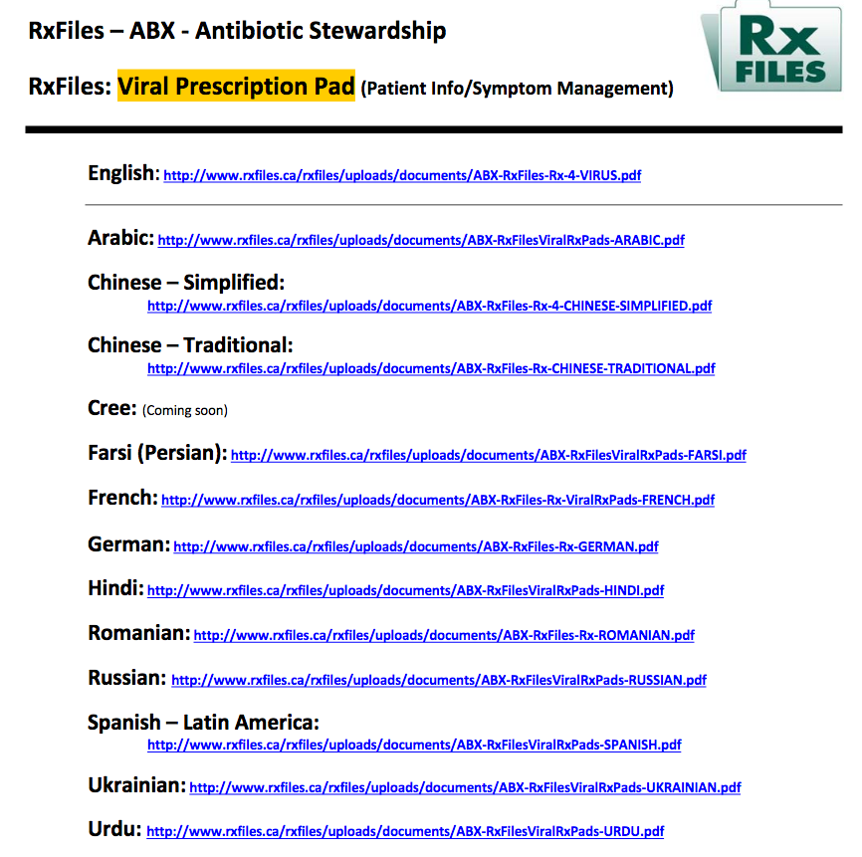
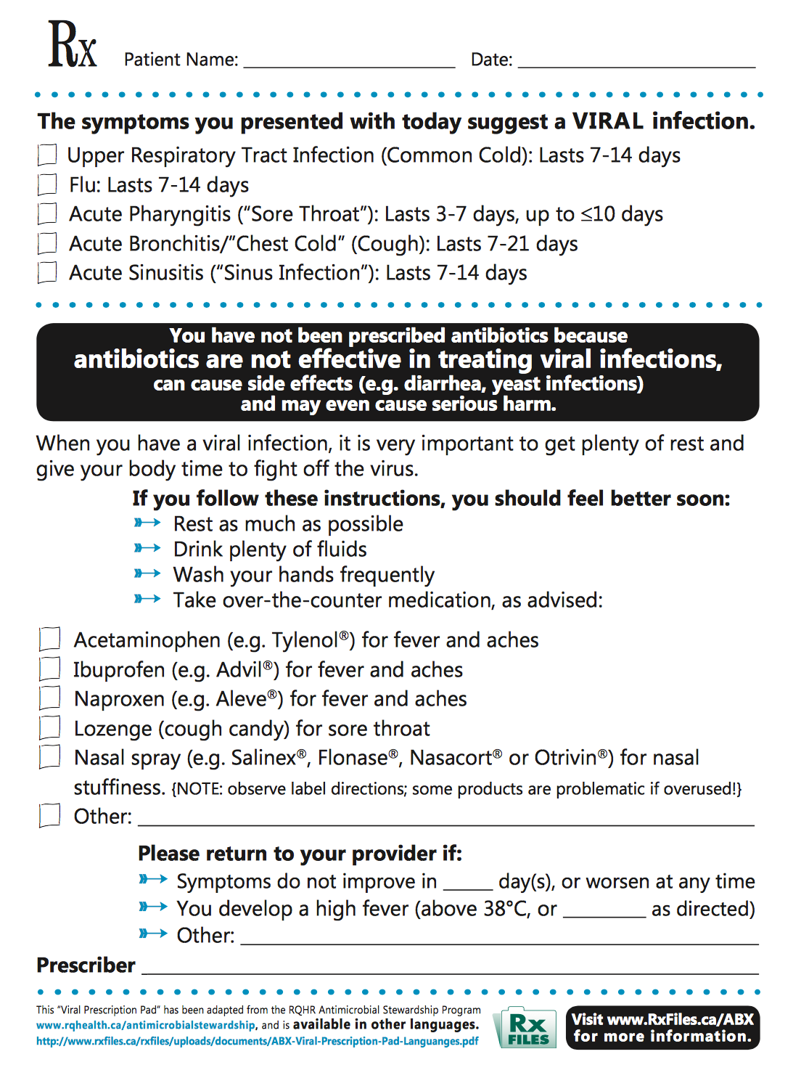

The streets
Making it easier to do the right thing
Viral Rx Pad
in 13 languages
https://www.rxfiles.ca/rxfiles/uploads/documents/ABX-RxFiles-Rx-4-VIRUS.pdf
L Regier

Slide 35
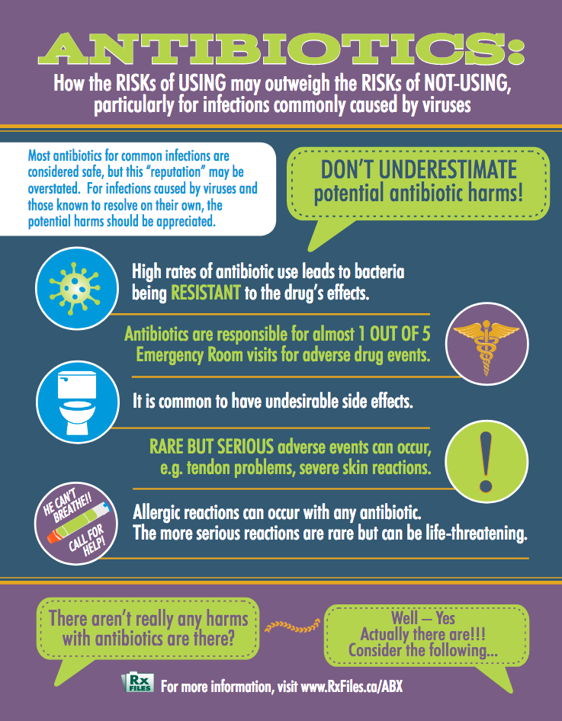
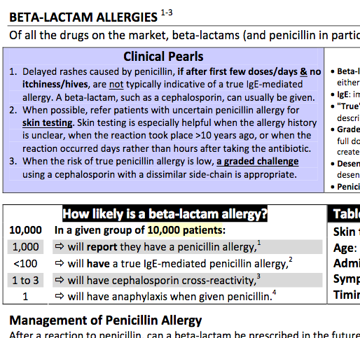
The streets
Making it easier to do the right thing
Additional materials online…or at our RxFiles conference table, e.g.
  ABX Harms
  Beta-Lactam Allergies
L Regier

Slide 36
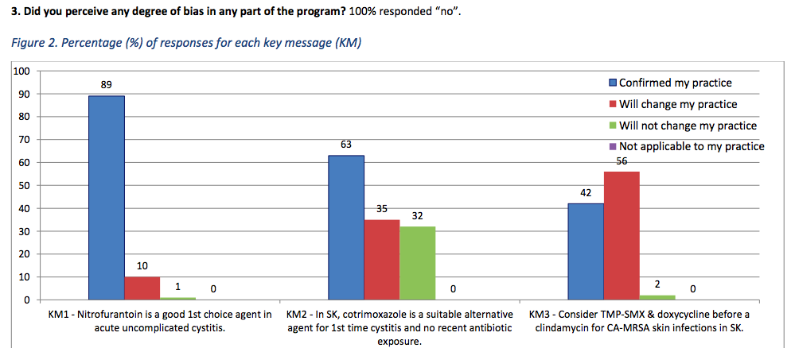
Impact
ABX Part 2: Acute Cystitis & Skin Infections (Fall 2017)
Providers Post-visit Survey - Excerpt
Survey also had lots of specific comments on individualized “take home pearls”

Slide 37
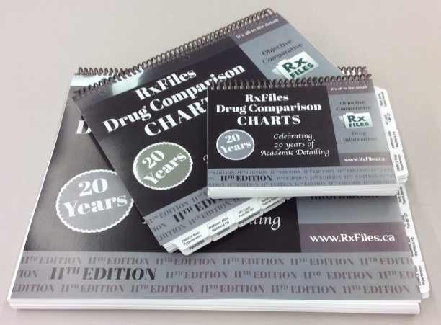
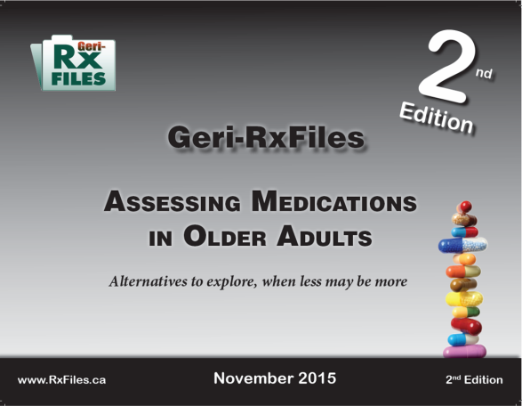
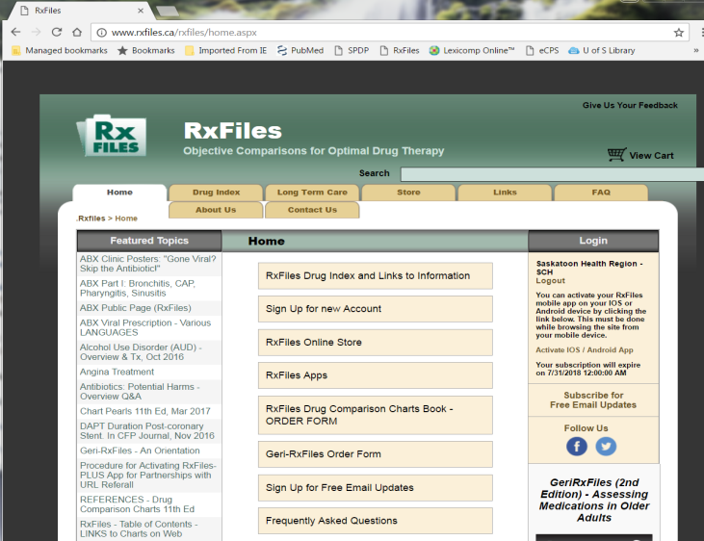
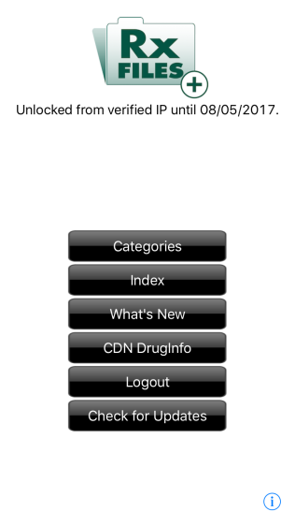
The Streets
Future ABX Updates
…will be updated for our books and online materials.
www.RxFiles.ca
Notes:
Books released ~every 2 years

Slide 38
Extras
Academic Detailing Code of Conduct
Academic Detailer Code of Conduct Canadian Academic Detailing Collaboration (CADC) This Code of Conduct recognizes the need for a commitment to excellence in the delivering of academic detailing as a professional service. Through such service, valued and effective relationships are built, and evidence informed, patient‐oriented therapeutic decision making is enhanced. Be prepared to provide accurate, informative, practical and balanced information Be responsible, reliable and respectful of time and commitments Seek first to understand and empathize Be respectful of differences of opinion and hold them in good faith and confidence Be attentive and responsive Follow up as necessary in a timely manner Remember to be thankful and express it Always maintain confidentiality and respect the privacy of physicians, patients and staff Remember, you are a guest of the person you are visiting

Slide 39

L Regier

Slide 40
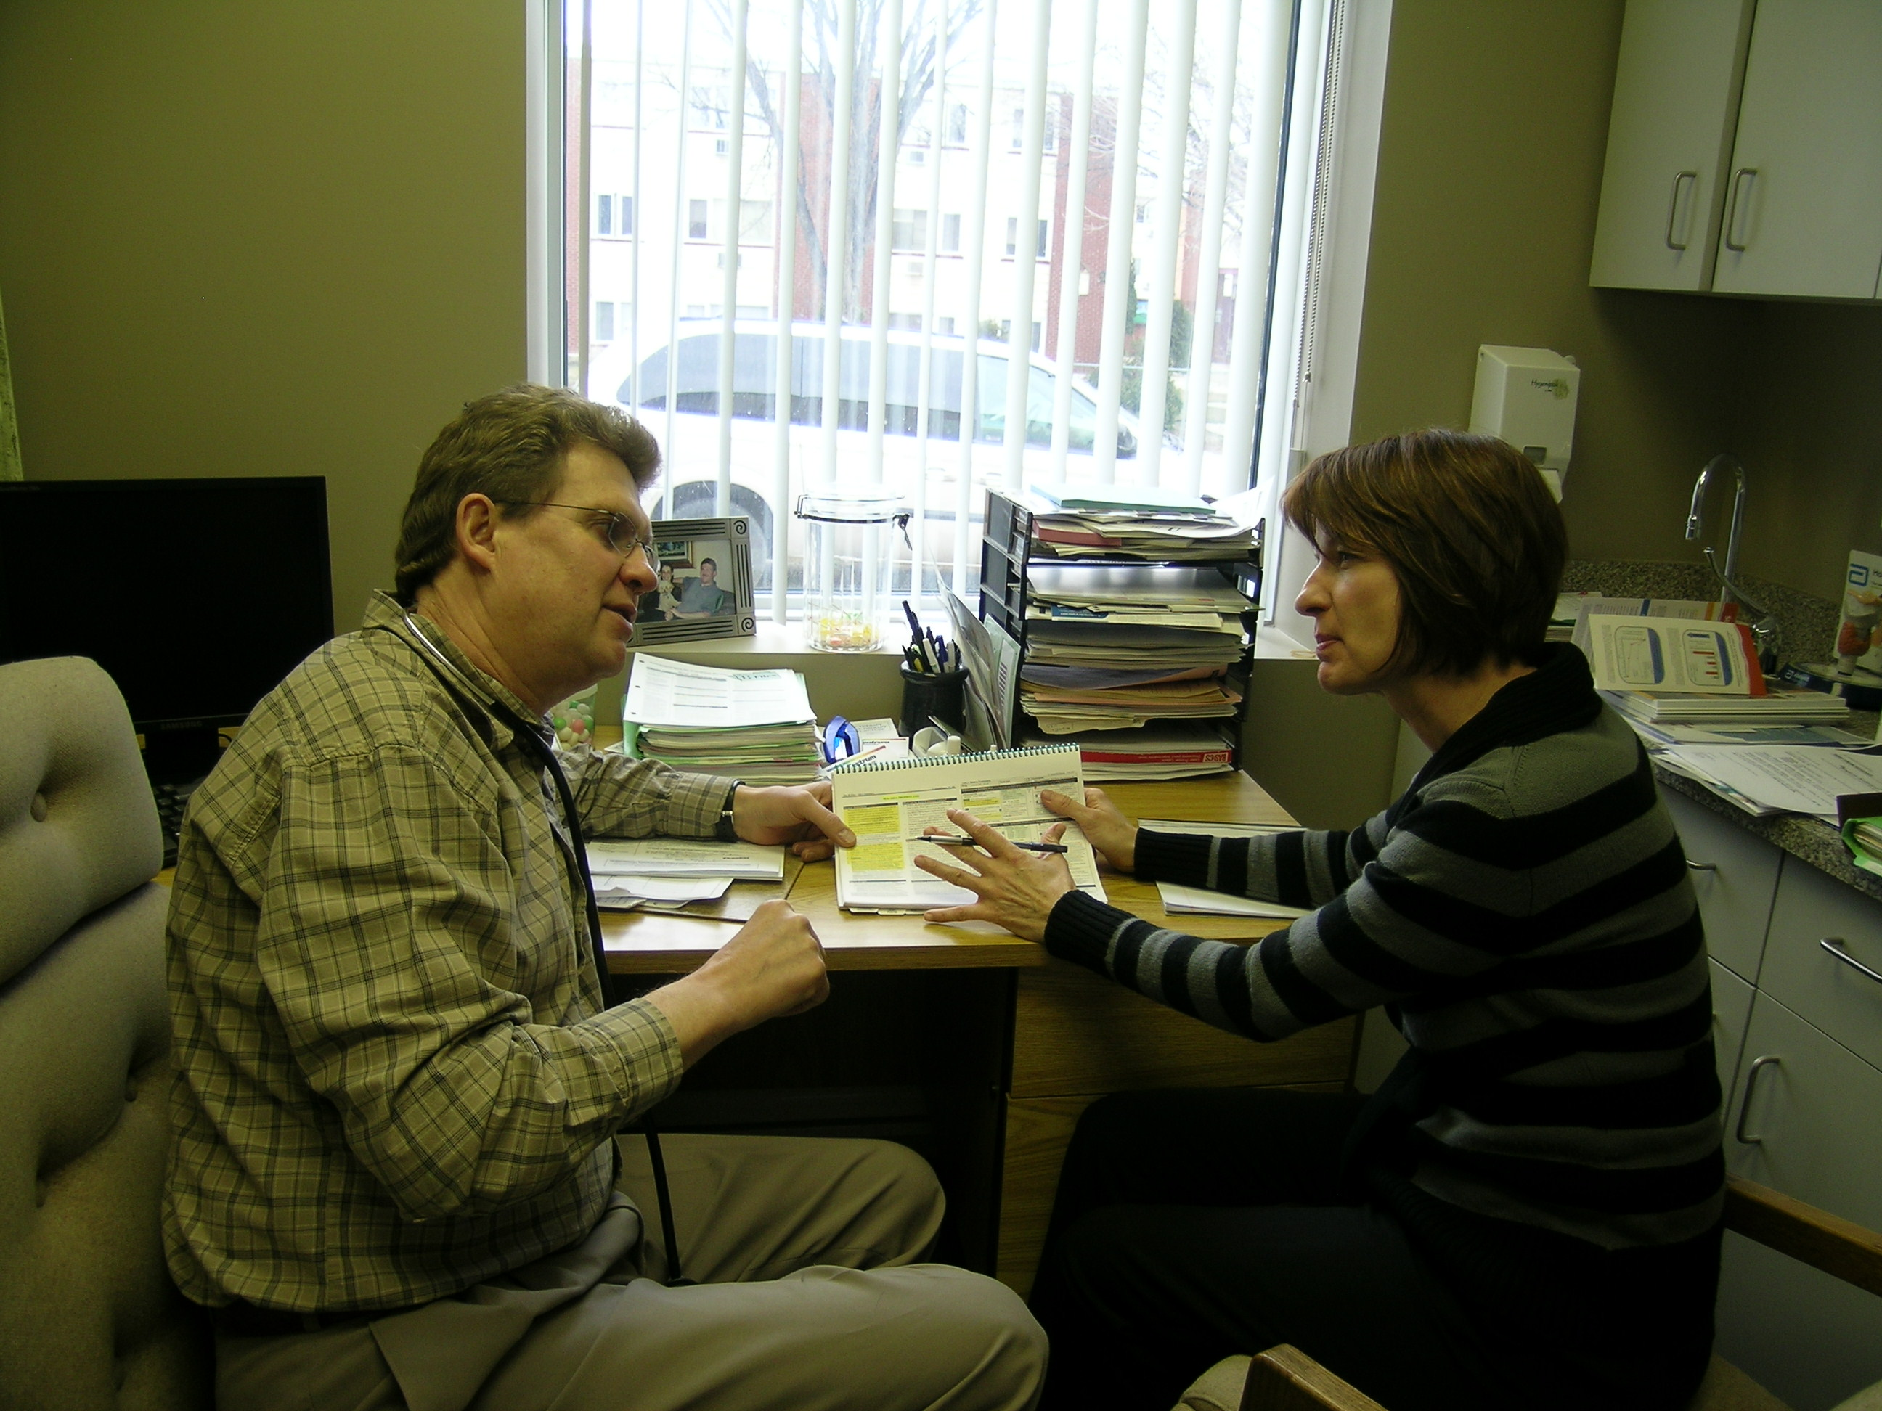

RxFiles
Academic Detailing
Questions & Comments
www.RxFiles.ca
Loren.RxFiles@usask.ca

