Slide 1
Opioids, Pain, and Addiction CDC, NACCHO, NaRCAD April 10, 2019
Don Teater MD, mph

Slide 2
Disclosure
Neither I nor any members of my immediate family have a financial interest/arrangement or affiliation that could be perceived as a real or apparent conflict of interest related to the content or supporters of this activity.

Slide 3
Common quote:
“Opioids are the most potent medications we have for treatment of pain.”
ASAM Principles of Addiction Medicine – Fifth edition. Chapter 97.

Slide 4
Opioid facts
The United States has 4.6% of the world’s population.
We use most of the worlds opioids!¹
83% of the world’s population has no access to any opioids.²

Slide 5
Opioid increase
Drug distribution through the pharmaceutical supply chain was the equivalent of 96 mg of morphine per person in 1997.
and approximately 640 mg per person in 2015, an increase of >500%.^{4, 48}
That is the equivalent of 128 Vicodin tablets!

Slide 6
Rates of opioid overdose deaths, sales and treatment admissions, US, 1999-2010.⁷

Slide 7
The State of US Health⁵ Years lived with disability (in thousands)
Notes:
US Burden of Disease Collaborators. The state of US health, 1990-2010: burden of diseases, injuries, and risk factors. JAMA. 2013 Aug 14;310(6):591-608. doi: 10.1001/jama.2013.13805. PubMed PMID: 23842577

Slide 8
2014 to 2017
U.S. life expectancy decreased 3 years in a row.
All driven by opioid overdoses!

Slide 9
Three key concepts:
Prescribers (and the public):
Don’t understand pain.
Don’t understand opioids.
Don’t understand addiction.

Slide 10
PAIN

Slide 11
Pain
An unpleasant sensory and emotional experience associated with actual or potential tissue damage, or described in terms of such damage.
International Association for the Study of Pain

Slide 12
and cognitive
Pain
An unpleasant sensory and emotional experience associated with actual or potential tissue damage, or described in terms of such damage.
International Association for the Study of Pain

Slide 13
Pain
Acute pain: Pain < 3 months
Chronic pain: Pain > 3 months
Acute pain is a symptom
Chronic pain is a disease

Slide 14
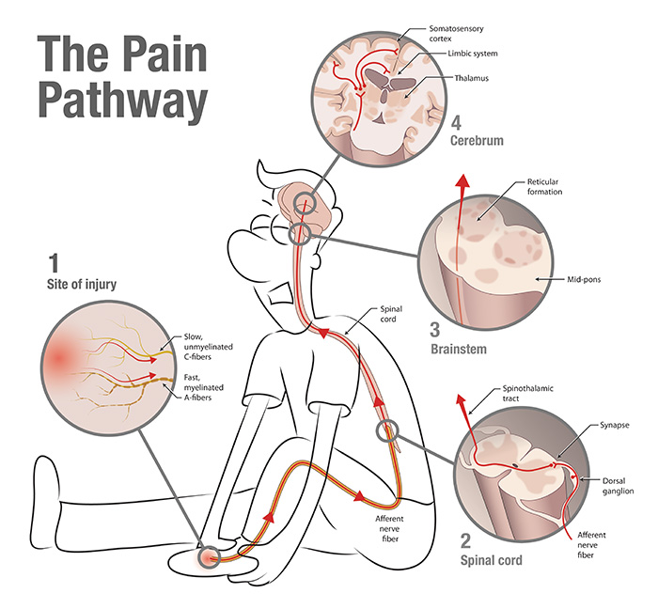

Slide 15
Important fact:
Our brain changes how we feel pain!

Slide 25
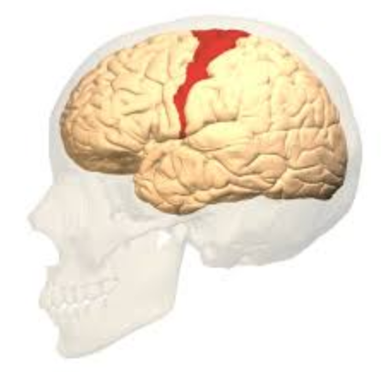
Pain pathways
Nociceptor
Spinothalamic nerve
Thalamus
Somatosensory nerve (pain)
Notes:
Image from: https://study.com/academy/lesson/somatosensory-cortex-definition-location-function.html

Slide 26
Pain pathways
Amygdala (fear)
Nociceptor
Spinothalamic nerve
Hippocampus (memory)
Thalamus
Somatosensory nerve (pain)
Limbic system (emotion)
Prefrontal cortex (rational thinking)

Slide 27
Central sensitization
Amygdala (fear)
Nociceptor
Spinothalamic nerve
Hippocampus (memory)
Thalamus
Somatosensory nerve (pain)
Limbic system (emotion)
Prefrontal cortex (rational thinking)

Slide 28
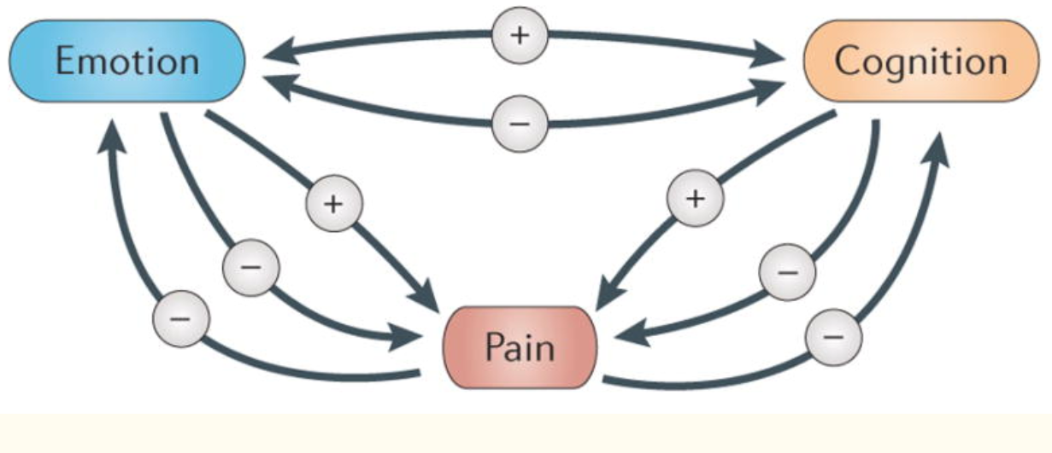
Bushnell MC, Ceko M, Low LA. Cognitive and emotional control of pain and its disruption in chronic pain. Nat Rev Neurosci. 2013;14(7):502-511. doi:10.1038/nrn3516

Slide 29
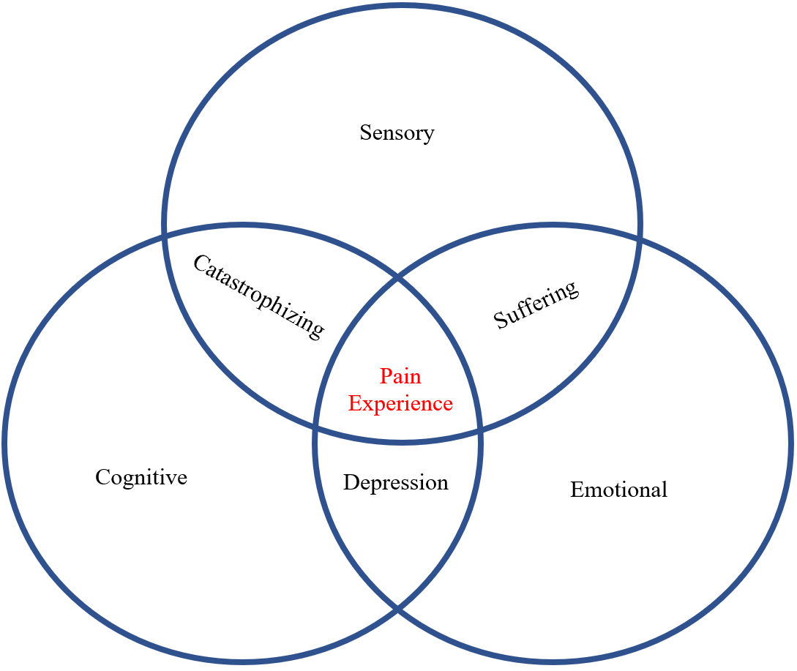

Slide 30
Central Sensitization Syndromes
Fibromyalgia
Chronic headaches
Irritable bowel syndrome
Chronic neck pain
Chronic back pain
Interstitial cystitis
All chronic pain???

Slide 31
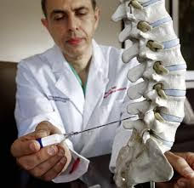
Radiofrequency denervation⁴⁹
Over 600 patients with CLBP and no improvement with conservative measures.
50% received denervation. All had a standardized exercise program.
No difference in pain at 3 months.
JAMA, 2017

Slide 32
OPIOIDS

Slide 33
Poppy plant

Slide 34
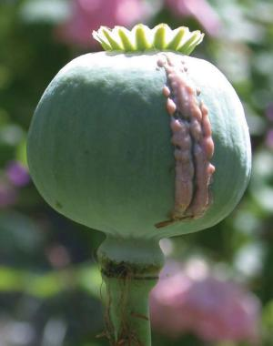

Slide 35
This is dopamine…

Slide 36
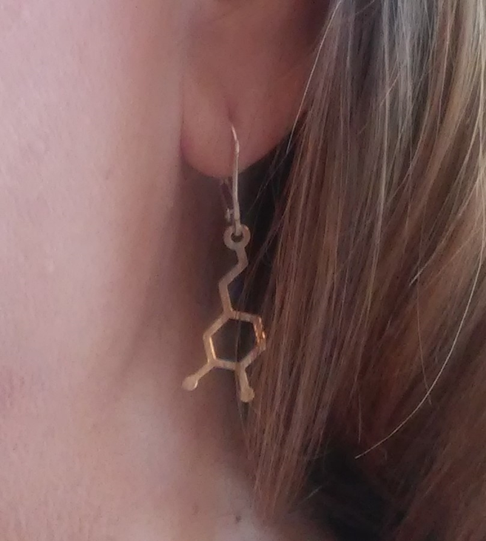
All addictive substances stimulate dopamine
Opioids
Alcohol
THC
Cocaine
Methamphetamine
Nicotine
LSD
Ecstasy
Others
Behaviors also….

Slide 37
Opioids are different…
Dopamine
+
Opioid receptors

Slide 38
Opioid receptors and endorphins
What is the purpose of our endorphins?
Enable us to achieve a goal (short term).^{23,24}
Decrease pain (minimal effect).
Increase motivation.
Increase confidence.
Increase reward.
Reduce depression and anxiety.
Increase “warmth-liking”.²⁵
Liking warm things.
Interpersonal bonding.
“My first pain pill felt like a warm hug”

Slide 39
Primary purpose:
Dopamine – Our primary reward system. This is what we live for.
Endorphins and opioid receptors – These maximize our ability to achieve the reward.
This is our “success system”!

Slide 41
The “Dorothy Reaction”
Occurs in susceptible individuals on exposure to opioids:
Those with acute or chronic stress/anxiety
Those with depression
Those with high ACE scores
Those with a genetic predisposition
Those with substance use disorder (including smoking)
Others…

Slide 42
Opioids given for pain may cause the “Dorothy Reaction” and:
Mentally impairing.^{8,9}
Delay recovery.^{10,11}
Increase medical costs.¹²
Opioid hyperalgesia.^{13,14}
Double the chance of disability (if prescribed for 7 days or more).¹⁵
Increase falls.¹⁶
Cardiac, GI?^{17,18}
Treat depression.¹⁹ (They are also very calming)
Brain changes.²⁰
Addiction.^{21,22}

Slide 43
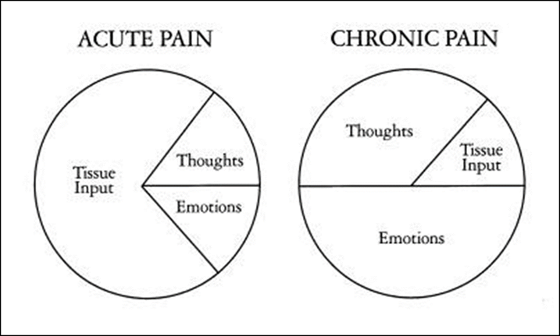
Opioids and Central Sensitization
Notes:
Reuben, D. B., Alvanzo, A. A. H., Ashikaga, T., Bogat, G. A., Callahan, C. M., Ruffing, V., & Steffens, D. C. (2015). National Institutes of Health Pathways to Prevention Workshop: The Role of Opioids in the Treatment of Chronic Pain. Annals of Internal Medicine, 162(4), 295. https://doi.org/10.7326/M14-2775

Slide 44
Addiction

Slide 45
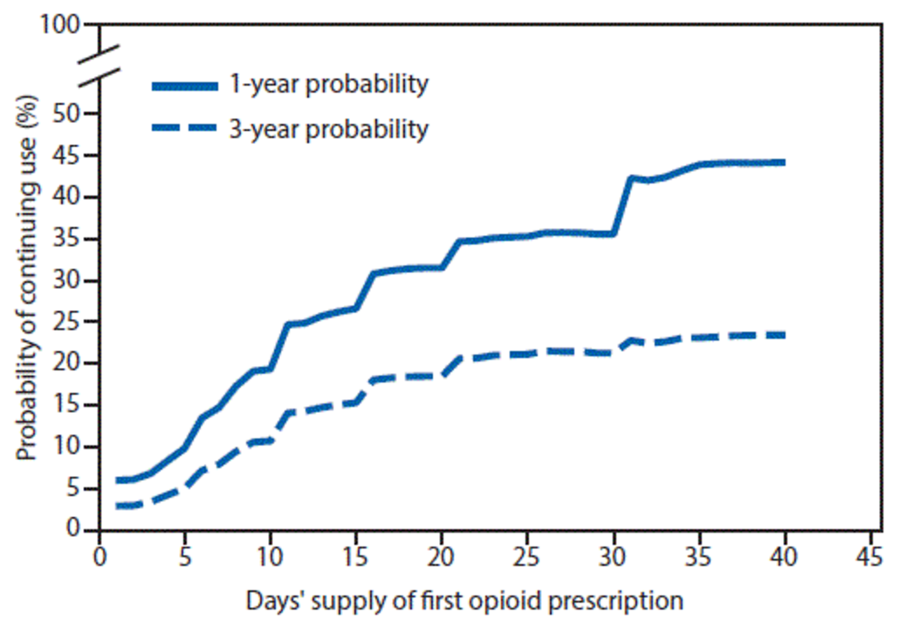
Acute rx leads to long-term use⁴⁷
Duration of acute use:
1 day - 6% chance of still using that drug a year later.
8 days - 13.5%.
31 days - 29.9%.

Slide 46
Teens who received a prescription for opioid pain medication by Grade 12 were at 33 percent increased risk of misusing an opioid between ages 19 and 25.
Among those with low predicted risk of future opioid use in 12th grade, having an opioid prescription increased their risk of post-high-school opioid misuse three-fold.

Slide 47
Adolescents and young adults who received a dental opioid rx
About 4% of people age 16-26 get an opioid prescription from a dentist each year.
Of those that got an rx from a dentist, 6.9% received another opioid rx 3-12 months later.
Only 0.1% of individuals who did not get an opioid got an rx 3-12 months later
5.8% of those that received an opioid had a health encounter with an opioid abuse related dx in the next year c/w 0.4% of those who did not get an opioid.⁶³
Notes:
Schroeder AR, Dehghan M, Newman TB, Bentley JP, Park KT. Association of Opioid Prescriptions From Dental Clinicians for US Adolescents and Young Adults With Subsequent Opioid Use and Abuse. JAMA Intern Med. 2018;Epub ahead. doi:10.1001/jamainternmed.2018.5419

Slide 48
Treating Pain

Slide 49
Efficacy of pain mediations Acute pain^{26,27,51}

Slide 50
ERAS outcomes
ERAS patients compared to controls:
Ambulated on POD 0: 77% (0%)
Any complication: 15% (30%)
Length of stay in days: 4.6 (6.8)
Hospital costs: $13,306 ($20,435)
Press-Ganey patient satisfaction: 98% (43%)

Slide 51
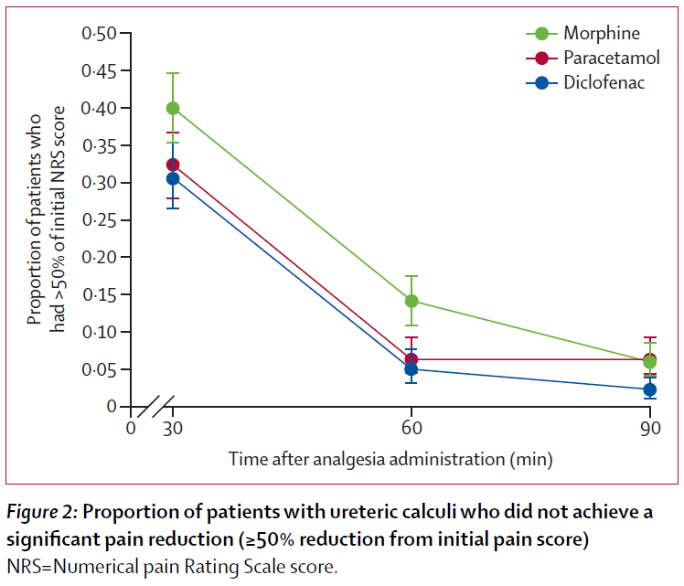
Renal colic

Slide 52
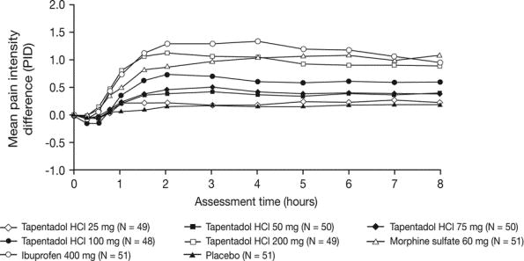
Single Dose Analgesic Efficacy of Tapentadol in Postsurgical Dental Pain: The Results of a Randomized, Double-Blind, Placebo-Controlled Study.
Kleinert, Regina; Lange, Claudia; MD, MSc; Steup, Achim; Black, Peter; Goldberg, Jutta; Desjardins, Paul; DMD, PhD
Anesthesia & Analgesia. 107(6):2048-2055, December 2008. DOI: 10.1213/ane.0b013e31818881ca
2

Slide 53
Acute pain conclusion:
We must prescribe fewer opioids for acute pain!
The CDC guidelines recommend 3 days or less – but most outpatient pain can be treated without any opioids!
The combination of ibuprofen + acetaminophen is the best treatment with the least side effects.

Slide 54
Chronic pain

Slide 55
Chronic pain
No evidence that opioids are effective for long-term treatment of chronic pain.³⁰
Epidemiologic studies have shown that those on chronic opioid therapy have worse quality of life than those with chronic pain who are not.³¹
The AAN recommends against using opioids for back pain, headaches, or fibromyalgia.³⁷

Slide 56
Treatment of chronic pain
Behavioral therapy³³
PT, OT
Treatment of mood disorders
Exercise
Acupuncture, yoga and other alternative therapies
Amitriptyline, duloxetine, gabapentin and similar drugs may help a little (10-30% pain reduction).

Slide 57
https://www.cdc.gov/drugoverdose/prescribing/guideline.html
Notes:
My role as facilitator was not because I was an expert in anything but had a broad knowledge in everything (pain, addiction, opioids). I will present this information today as a practicing physician.
I could go over this guideline item by item but that would not be helpful. I want to give you a basic understanding that you won’t forget that will help you use this guideline more effectively in your patient care.

Slide 58
Determining When to Initiate or Continue Opioids for Chronic Pain
1. Nonpharmacologic therapy and nonopioid pharmacologic therapy are preferred for chronic pain. Clinicians should consider opioid therapy only if expected benefits for both pain and function are anticipated to outweigh risks to the patient. If opioids are used, they should be combined with nonpharmacologic therapy and nonopioid pharmacologic therapy, as appropriate.
2. Before starting opioid therapy for chronic pain, clinicians should establish treatment goals with all patients, including realistic goals for pain and function, and should consider how therapy will be discontinued if benefits do not outweigh risks. Clinicians should continue opioid therapy only if there is clinically meaningful improvement in pain and function that outweighs risks to patient safety.
3. Before starting and periodically during opioid therapy, clinicians should discuss with patients known risks and realistic benefits of opioid therapy and patient and clinician responsibilities for managing therapy.
Opioid Selection, Dosage, Duration, Follow-Up, and Discontinuation
4. When starting opioid therapy for chronic pain, clinicians should prescribe immediate-release opioids instead of extended-release/long-acting (ER/LA) opioids.
5. When opioids are started, clinicians should prescribe the lowest effective dosage. Clinicians should use caution when prescribing opioids at any dosage, should carefully reassess evidence of individual benefits and risks when increasing dosage to ≥50 morphine milligram equivalents (MME)/day, and should avoid increasing dosage to ≥90 MME/day or carefully justify a decision to titrate dosage to ≥90 MME/day.
6. Long-term opioid use often begins with treatment of acute pain. When opioids are used for acute pain, clinicians should prescribe the lowest effective dose of immediate-release opioids and should prescribe no greater quantity than needed for the expected duration of pain severe enough to require opioids. Three days or less will often be sufficient; more than seven days will rarely be needed.
7. Clinicians should evaluate benefits and harms with patients within 1 to 4 weeks of starting opioid therapy for chronic pain or of dose escalation. Clinicians should evaluate benefits and harms of continued therapy with patients every 3 months or more frequently. If benefits do not outweigh harms of continued opioid therapy, clinicians should optimize other therapies and work with patients to taper opioids to lower dosages or to taper and discontinue opioids.
Assessing Risk and Addressing Harms of Opioid Use
8. Before starting and periodically during continuation of opioid therapy, clinicians should evaluate risk factors for opioid-related harms. Clinicians should incorporate into the management plan strategies to mitigate risk, including considering offering naloxone when factors that increase risk for opioid overdose, such as history of overdose, history of substance use disorder, higher opioid dosages (≥50 MME/day), or concurrent benzodiazepine use, are present.
9. Clinicians should review the patient’s history of controlled substance prescriptions using state prescription drug monitoring program (PDMP) data to determine whether the patient is receiving opioid dosages or dangerous combinations that put him or her at high risk for overdose. Clinicians should review PDMP data when starting opioid therapy for chronic pain and periodically during opioid therapy for chronic pain, ranging from every prescription to every 3 months.
10. When prescribing opioids for chronic pain, clinicians should use urine drug testing before starting opioid therapy and consider urine drug testing at least annually to assess for prescribed medications as well as other controlled prescription drugs and illicit drugs.
11. Clinicians should avoid prescribing opioid pain medication and benzodiazepines concurrently whenever possible.
12. Clinicians should offer or arrange evidence-based treatment (usually medication-assisted treatment with buprenorphine or methadone in combination with behavioral therapies) for patients with opioid use disorder.
Notes:
5 min summary slide. You won’t remember this but can refer back to it.

Slide 59
CDC Guidelines
1. Nonpharmacologic therapy and nonopioid pharmacologic therapy are preferred for chronic pain. Clinicians should consider opioid therapy only if expected benefits for both pain and function are anticipated to outweigh risks to the patient.
2. Clinicians should continue opioid therapy only if there is clinically meaningful improvement in pain and function that outweighs risks to patient safety.
6. For acute pain. Use opioids for 3 days or less.
12. Clinicians should offer or arrange evidence-based treatment (usually medication-assisted treatment with buprenorphine or methadone in combination with behavioral therapies).

Slide 60
VA/DOD Guidelines 2017

Slide 61
When are opioids definitely indicated?
Following severe trauma (for a short period)
End of life

Slide 62
Tapering – why taper?
No clinical improvement on opioids
Risk outweighs benefit
Aberrant behavior
Patient request

Slide 63
Tapering opioids
Opioid taper in people on COT resulted in average pain decrease from 7.1 to 5.4. A 24% decrease in pain. About ½ of patients ended up going back on opioids but their pain was not improved on the opioids.³⁴
Taper off of COT reduces pain in all ages. Approximate 20% reduction. Also reduction in depression and pain catastrophizing.³⁵
(Krumova et al., 2013) (Darchuk, Townsend, Rome, Bruce, & Hooten, 2010)

Slide 64
Darnall Study details
Patients in an outpatient pain clinic.
Given a booklet on pain and taper suggestions.
110 eligible for taper
82 agreed to taper (75%)
51 (of 82) completed 4 months and final survey
Mean MED decreased from 288 to 150
About 90% were able to decrease their dose
86% had no change or a decrease in their pain
(Darnall et al., 2018)

Slide 65
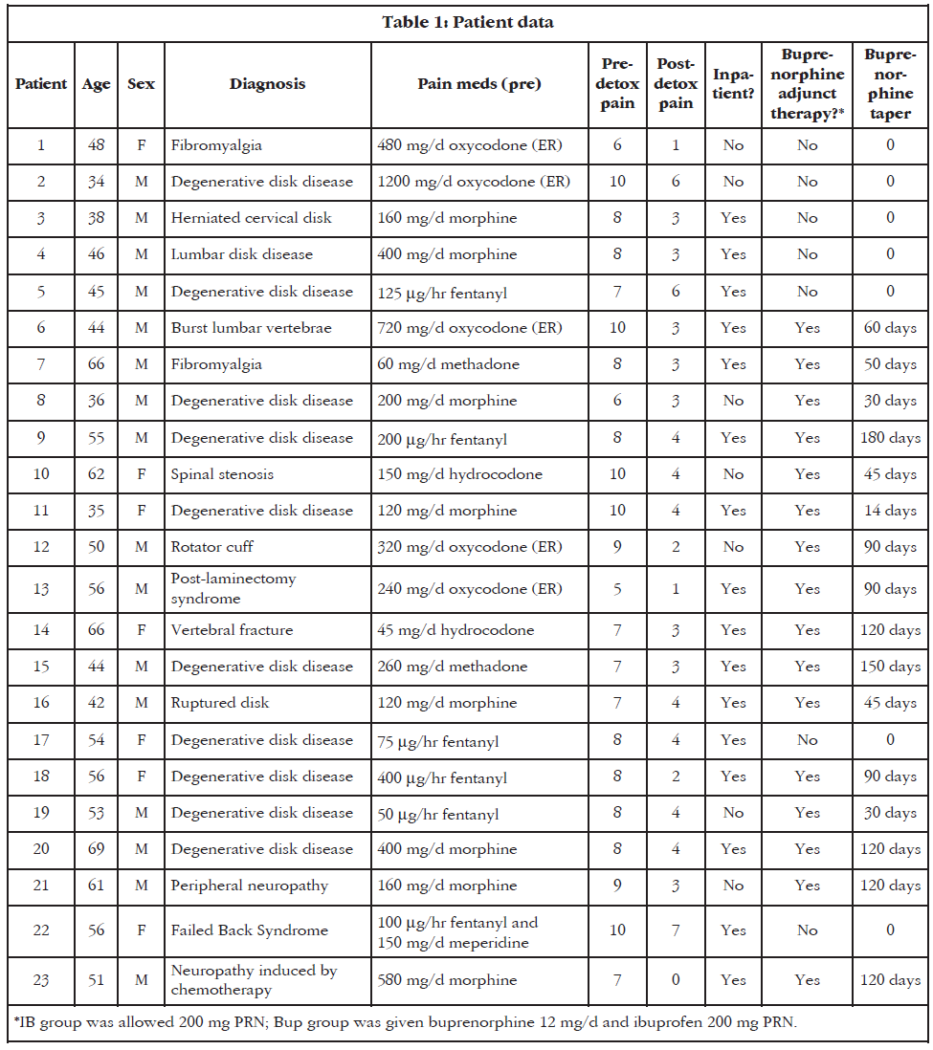
Pain reduction in patients undergoing voluntary wean from high-dose opioids.
(Baron & McDonald, 2006)
Notes:
Baron, M., & McDonald, P. (2006). Significant pain reduction in chronic pain patients after detoxification from high-dose opioids. J Opioid Manag, 2(5), 277–282. Retrieved from http://www.rsds.org/pdfsall/Baron_McDonald.pdf

Slide 66
Opioid withdrawal
Enhances central sensitization and recalls old pain memories. This is called “withdrawal-associated injury site pain (WISP) – Rieb.

Slide 67
Weaning protocols
There is NO standard protocol.
Some recommend 10% of opioid dose reduction q month.
Slow taper: Less withdrawal sxs but for prolonged period.
Faster taper: Greater symptoms but shorter period of time.

Slide 68
Weaning protocols
Consider:
Change to buprenorphine and wean off.
Change to short acting opioids to make smaller dose changes.

Slide 69
Problematic withdrawal sxs:
Increased pain
Increased anxiety
Increased depression

Slide 70
Buprenorphine for pain
Some patients will not be able to wean.
Transition to buprenorphine is better than having them leave your practice.

Slide 71
Potential key messages
Use non-opioid treatment as the first line for acute or chronic pain
If opioids are needed, start prescribing at the lowest effective dose
Use available PDMP Data to determine if patients have previously filled prescriptions for opioids or other controlled medications
Offer patients with Opioid Use Disorder (OUD) a range of treatment options, including medication assisted treatment (MAT).
Complete training for buprenorphine (Suboxone) prescribing to be able to offer MAT to patients with OUD.

Slide 72
“To write prescriptions is easy,
but to come to an understanding with
people is hard.”
-- Franz Kafka, “A Country Doctor”

Slide 73
Don Teater MD, MPH
Teater Health Solutions
teaterhs.com
don@teaterhs.com

Slide 74
References:
1. Solanki DR, Koyyalagunta D, Shah R V, Silverman SM, Manchikanti L. Monitoring opioid adherence in chronic pain patients: assessment of risk of substance misuse. Pain Physician. 2011;14(2):E119-E131. http://www.ncbi.nlm.nih.gov/pubmed/21412377.
2. Seya M-J, Gelders SF a M, Achara OU, Milani B, Scholten WK. A first comparison between the consumption of and the need for opioid analgesics at country, regional, and global levels. J Pain Palliat Care Pharmacother. 2011;25(1):6-18. doi:10.3109/15360288.2010.536307.
3. NIDA. Safe Prescribing for Pain. 2016. https://www.drugabuse.gov/nidamed/etools/safe-prescribing-pain.
4. Paulozzi LJ, Baldwin G. CDC Grand Rounds: Prescription Drug Overdoses — a U.S. Epidemic. MMWR. 2012;61(1):10-13.
5. Murray C. The state of US health, 1990-2010: burden of diseases, injuries, and risk factors. JAMA. 2013;310(6):591-608. doi:10.1001/jama.2013.13805.
6. Birnbaum HG, White AG, Schiller M, Waldman T, Cleveland JM, Roland CL. Societal Costs of Prescription Opioid Abuse , Dependence , and Misuse in the United States. Pain Med. 2011;12:657-667.
7. Paulozzi LJ, Jones CM, Mack KA, Rudd RA. Vital signs: overdoses of prescription opioid pain relievers---United States, 1999--2008. MMWR Morb Mortal Wkly Rep. 2011;60(43):1487-1492. http://www.ncbi.nlm.nih.gov/pubmed/22048730.
8. Cherrier MM, Amory JK, Ersek M, Risler L, Shen DD. Comparative cognitive and subjective side effects of immediate-release oxycodone in healthy middle-aged and older adults. J Pain. 2009;10(10):1038-1050. doi:10.1016/j.jpain.2009.03.017.
9. Gooch CM, Rakitin BC, Cooper ZD, Comer SD, Balsam PD. Oxycodone lengthens reproductions of suprasecond time intervals in human research volunteers. Behav Pharmacol. 2011;22(4):354-361. doi:10.1097/FBP.0b013e328348d8b8.
10. Thiele RH, Rea KM, Turrentine FE, et al. Standardization of Care: Impact of an Enhanced Recovery Protocol on Length of Stay, Complications, and Direct Costs after Colorectal Surgery. J Am Coll Surg. 2015;220(4):430-443. doi:10.1016/j.jamcollsurg.2014.12.042.
11. Woller S a., Hook M a. Opioid administration following spinal cord injury: Implications for pain and locomotor recovery. Exp Neurol. 2013;247:328-341. doi:10.1016/j.expneurol.2013.03.008.
12. White J a, Tao X, Talreja M, Tower J, Bernacki E. The effect of opioid use on workers’ compensation claim cost in the State of Michigan. J Occup Environ Med. 2012;54(8):948-953. doi:10.1097/JOM.0b013e318252249b.

Slide 75
References:
13. Edlund MJ, Martin BC, Russo JE, Devries A, Braden JB, Sullivan MD. The Role of Opioid Prescription in Incident Opioid Abuse and Dependence Among Individuals With Chronic Noncancer Pain. Clin J Pain. 2014;30(7):557-564.
14. Chu LF, Clark DJ, Angst MS. Opioid tolerance and hyperalgesia in chronic pain patients after one month of oral morphine therapy: a preliminary prospective study. J Pain. 2006;7(1):43-48. doi:10.1016/j.jpain.2005.08.001.
15. Webster BS, Verma SK, Gatchel RJ. Relationship between early opioid prescribing for acute occupational low back pain and disability duration, medical costs, subsequent surgery and late opioid use. Spine (Phila Pa 1976). 2007;32(19):2127-2132. doi:10.1097/BRS.0b013e318145a731.
16. Miller M, Stu ÃT, Azrael D. Opioid Analgesics and the Risk of Fractures in Older Adults with Arthritis. J Am Geriatr Soc. 2011;59:430-438. doi:10.1111/j.1532-5415.2011.03318.x.
17. Ray WA, Chung CP, Murray KT, et al. Prescription of Long-Acting Opioids and Mortality in Patients With Chronic Noncancer Pain. JAMA. 2016;315(22):2415. doi:10.1001/jama.2016.7789.
18. Solomon DH, Rassen J a, Glynn RJ, Lee J, Levin R, Schneeweiss S. The comparative safety of analgesics in older adults with arthritis. Arch Intern Med. 2010;170(22):1968-1976. doi:10.1001/archinternmed.2010.391.
19. Tenore PL. Psychotherapeutic benefits of opioid agonist therapy. J Addict Dis. 2008;27(3):49-65. doi:10.1080/10550880802122646.
20. Younger JW, Chu LF, D’Arcy NT, Trott KE, Jastrzab LE, Mackey SC. Prescription opioid analgesics rapidly change the human brain. Pain. 2011;152(8):1803-1810. doi:10.1016/j.pain.2011.03.028.
21. Martell B, O’Connor P, Kerns R, et al. Systematic review: opioid treatment for chronic back pain: prevalence, efficacy, and association with addiction. Ann Intern Med. 2007;146(2):116-127. http://annals.org/article.aspx?articleid=732048. Accessed August 9, 2014.
22. Odgers CL, Caspi A, Nagin DS, et al. Is it important to prevent early exposure to drugs and alcohol among adolescents? Psychol Sci. 2008;19(10):1037-1044. doi:10.1111/j.1467-9280.2008.02196.x.
23. Polunina AG, Bryun E a. Neuropsychological Functions of μ- and δ-Opioid Systems. ISRN Addict. 2013;2013:1-13. doi:10.1155/2013/674534.
24. Inagaki TK, Ray LA, Irwin MR, Way BM, Eisenberger NI. Opioids and social bonding: Naltrexone reduces feelings of social connection. Soc Cogn Affect Neurosci. 2016;epub ahead:1-8. doi:10.1093/scan/nsw006.
25. Schweiger D, Stemmler G, Burgdorf C, Wacker J. Opioid receptor blockade and warmth-liking: Effects on interpersonal trust and frontal asymmetry. Soc Cogn Affect Neurosci. 2014;9(10):1608-1615. doi:10.1093/scan/nst152.
26. Teater D. Evidence for the Efficacy of Pain Medications. Itasca, Illinois; 2014. www.nsc.org/painmedevidence.

Slide 76
References:
27. Moore RA, Derry S, McQuay HJ, Wiffen PJ. Single dose oral analgesics for acute postoperative pain in adults. Cochrane Database Syst Rev. 2011;9(9):CD008659. doi:10.1002/14651858.CD008659.pub2.
28. Holdgate A, Pollock T. Nonsteroidal anti-inflammatory drugs ( NSAIDs ) versus opioids for acute renal colic. Cochrane Database Syst Rev. 2004;(1):Art. No.: CD004137. doi:10.1002/14651858.CD004137.pub3.
29. Kleinert R, Lange C, Steup A, Black P, Goldberg J, Desjardins P. Single dose analgesic efficacy of tapentadol in postsurgical dental pain: The results of a randomized, double-blind, placebo-controlled study. Anesth Analg. 2008;107(6):2048-2055. doi:10.1213/ane.0b013e31818881ca.
30. Dowell D, Haegerich TM, Chou R. CDC Guideline for Prescribing Opioids for Chronic Pain — United States, 2016. MMWR. 2016;65. doi:10.1001/jama.2016.1464.
31. Eriksen J, Sjøgren P, Bruera E, Ekholm O, Rasmussen NK. Critical issues on opioids in chronic non-cancer pain: an epidemiological study. Pain. 2006;125(1-2):172-179. doi:10.1016/j.pain.2006.06.009.
32. Afilalo M, Etropolski MS, Kuperwasser B, et al. Efficacy and Safety of Tapentadol Extended Release Compared with Oxycodone Controlled Release for the Management of Moderate to Severe Chronic Pain Related to Osteoarthritis of the Knee: A Randomized, Double-Blind, Placebo- and Active-Controlled Phase III. Clin Drug Investig. 2010;30(8):489-505. doi:1 [pii]\n10.2165/11533440-000000000-00000.
33. Cherkin DC, Sherman KJ, Balderson BH, et al. Effect of Mindfulness-Based Stress Reduction vs Cognitive Behavioral Therapy or Usual Care on Back Pain and Functional Limitations in Adults With Chronic Low Back Pain. JAMA. 2016;315(12):1240. doi:10.1001/jama.2016.2323.
34. Krumova EK, Bennemann P, Kindler D, Schwarzer A, Zenz M, Maier C. Low pain intensity after opioid withdrawal as a first step of a comprehensive pain rehabilitation program predicts long-term nonuse of opioids in chronic noncancer pain. Clin J Pain. 2013;29(9):760-769. doi:10.1097/AJP.0b013e31827c7cf6.
35. Darchuk KM, Townsend CO, Rome JD, Bruce BK, Hooten WM. Longitudinal treatment outcomes for geriatric patients with chronic non-cancer pain at an interdisciplinary pain rehabilitation program. Pain Med. 2010;11(9):1352-1364. doi:10.1111/j.1526-4637.2010.00937.x.
36. da Costa B, Nüesch E, Aws R, et al. Oral or transdermal opioids for osteoarthritis of the knee or hip ( Review ) Oral or transdermal opioids for osteoarthritis of the knee or hip. Cochrane Database Syst Rev. 2014;(9). doi:10.1002/14651858.CD003115.pub3.Copyright.
37. Franklin GM. Opioids for chronic noncancer pain: a position paper of the American Academy of Neurology. Neurology. 2014;83(14):1277-1284. doi:10.1212/WNL.0000000000000839.

Slide 77
References:
38. Balague F, Mannion AF, Pellise F, Cedraschi C. Non-specific low back pain. Lancet. 2012;379(9814):482-491. doi:10.1016/S0140-6736(11)60610-7.
39. Artus M, van der Windt DA, Jordan KP, Hay EM. Low back pain symptoms show a similar pattern of improvement following a wide range of primary care treatments: A systematic review of randomized clinical trials. Rheumatology. 2010;49(12):2346-2356. doi:10.1093/rheumatology/keq245.
40. Cherkin DC, Sherman KJ, Balderson BH, et al. Effect of Mindfulness-Based Stress Reduction vs Cognitive Behavioral Therapy or Usual Care on Back Pain and Functional Limitations in Adults With Chronic Low Back Pain. JAMA. 2016;315(12):1240. doi:10.1001/jama.2016.2323.
41. Webster BS, Verma SK, Gatchel RJ. Relationship between early opioid prescribing for acute occupational low back pain and disability duration, medical costs, subsequent surgery and late opioid use. Spine (Phila Pa 1976). 2007;32(19):2127-2132. doi:10.1097/BRS.0b013e318145a731.
42. Franklin GM, Stover BD, Turner J a, Fulton-Kehoe D, Wickizer TM. Early opioid prescription and subsequent disability among workers with back injuries: the Disability Risk Identification Study Cohort. Spine (Phila Pa 1976). 2008;33(2):199-204. doi:10.1097/BRS.0b013e318160455c.
43. Edlund MJ, Martin BC, Russo JE, Devries A, Braden JB, Sullivan MD. The Role of Opioid Prescription in Incident Opioid Abuse and Dependence Among Individuals With Chronic Noncancer Pain. Clin J Pain. 2014;30(7):557-564.
44. Lee D, Armaghani S, Archer KR, et al. Preoperative Opioid Use as a Predictor of Adverse Postoperative Self-Reported Outcomes in Patients Undergoing Spine Surgery. J Bone Jt Surg. 2014;96(11):e89-e89. doi:10.2106/JBJS.M.00865.
45. Shaheed CA, Maher CG, Williams KA, Day R, Mclachlan AJ. Efficacy, Tolerability, and Dose-Dependent Effects of Opioid Analgesics for Low Back Pain A Systematic Review and Meta-analysis. JAMA Intern Med. 2016;176(7):958-968. doi:10.1001/jamainternmed.2016.1251.
46. Eriksen J, Sjøgren P, Bruera E, Ekholm O, Rasmussen NK. Critical issues on opioids in chronic non-cancer pain: an epidemiological study. Pain. 2006;125(1-2):172-179. doi:10.1016/j.pain.2006.06.009.

Slide 78
References:
47. Shah A, Hayes CJ, Martin BC. Characteristics of Initial Prescription Episodes and Likelihood of Long-Term Opioid Use — United States, 2006–2015. MMWR Morb Mortal Wkly Rep 2017;66:265–269. DOI: http://dx.doi.org/10.15585/mmwr.mm6610a1
48. Guy, G. P., Zhang, K., Bohm, M. K., Losby, J., Lewis, B., Young, R., … Dowell, D. (2017). Vital Signs: Changes in Opioid Prescribing in the United States, 2006–2015. MMWR. Morbidity and Mortality Weekly Report, 66(26), 697–704. https://doi.org/10.15585/mmwr.mm6626a4
49. Juch, J. N. S., Maas, E. T., Ostelo, R. W. J. G., Groeneweg, J. G., Kallewaard, J.-W., Koes, B. W., … van Tulder, M. W. (2017). Effect of Radiofrequency Denervation on Pain Intensity Among Patients With Chronic Low Back Pain. JAMA, 318(1), 14. https://doi.org/10.1001/jama.2017.7918
50. Shaw, W. S., Hartvigsen, J., Woiszwillo, M. J., Linton, S. J., & Reme, S. E. (2016). Psychological Distress in Acute Low Back Pain: A Review of Measurement Scales and Levels of Distress Reported in the First 2 Months After Pain Onset. Archives of Physical Medicine and Rehabilitation, 97(9), 1573–1587. https://doi.org/10.1016/j.apmr.2016.02.004
51. Derry, C., Derry, S., & Moore, R. (2013). Single dose oral ibuprofen plus paracetamol ( acetaminophen ) for acute postoperative pain ( Review ). Cochrane Database of Systemic Reviews, (6). https://doi.org/10.1002/14651858.CD010210.pub2
52. Thiele, R. H., Rea, K. M., Turrentine, F. E., Friel, C. M., Hassinger, T. E., Goudreau, B. J., … McMurry, T. L. (2015). Standardization of Care: Impact of an Enhanced Recovery Protocol on Length of Stay, Complications, and Direct Costs after Colorectal Surgery. Journal of the American College of Surgeons, 220(4), 430–443. http://doi.org/10.1016/j.jamcollsurg.2014.12.042
53. Davis, M. A., Lin, L. A., Liu, H., & Sites, B. D. (2017). Prescription Opioid Use among Adults with Mental Health Disorders in the United States. The Journal of the American Board of Family Medicine, 30(4), 407–417. https://doi.org/10.3122/jabfm.2017.04.170112

Slide 79
References:
65. Strang, J., McCambridge, J., Best, D., Beswick, T., Bearn, J., Rees, S., & Gossop, M. (2003). Loss of tolerance and overdose mortality after inpatient opiate detoxification: follow up study. BMJ, 326(7396), 959–960. https://doi.org/10.1136/bmj.326.7396.959

