Slide 1
Evidence-based Medicine
and Academic Detailing
in the 21st Century
Michael A. Fischer, M.D., M.S.
Director, National Resource Center for Academic Detailing
Division of Pharmacoepidemiology and Pharmacoeconomics
Brigham and Women’s Hospital
Harvard Medical School

Slide 2
Sources of Support
NaRCAD is supported by a grant from the Agency for Healthcare Research and Quality (AHRQ)
My current research projects are funded by AHRQ, PCORI, and non-profit foundations.
I consult for the Alosa Foundation, a non-profit that supports academic detailing programs. I do not accept personal compensation of any kind from any pharmaceutical companies, health insurers, or device manufacturers.
DoPE accepts occasional unrestricted research grants from drug companies or health insurance companies to study specific drug safety and utilization questions.

Slide 3
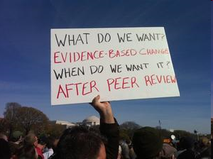
Today’s Theme: (from the Rally to Restore Sanity, Oct. 2010)

Slide 4
The Lay of the Land
Medical care should be effective, safe, and as affordable as possible.
But:
We know that medical care is not optimal
Effective therapies underused
Adverse events and errors common
Patients struggle to pay medical bills
and programs have trouble with rising expenses…

Slide 5
Potential of Modern Medicine
Tremendous reductions in morbidity and mortality
Cardiovascular disease
HIV infection
Gastrointestinal disease
and many other areas

Slide 6
Potential Not Achieved
Underuse of beneficial treatments
Beta-blockers/statins post-MI
Insulin for diabetes
Treatment of depression
Screening for colorectal cancer
Just publishing research is not enough
ALLHAT and treatment of hypertension
Notes:
6

Slide 7
Causing Bad Outcomes
Use in different populations
Spironolactone and the RALES trials
Side effects not previously recognized
Implantable defibrillators
Rosiglitazone (Avandia)
Rofecoxib (Vioxx)
Ineffective for important endpoints
Ezetimibe (Zetia)
Opportunity cost of ineffective care

Slide 8
Making Expensive Choices
Coronary artery disease
Persistent use of stents for stable angina
Hypertension
<10% of patients prescribed thiazides (Fischer and Avorn, 2004)
Clopidogrel
50% of use not indicated (Choudhry, 2008)
More costly prescriptions decrease adherence
Both for new prescriptions (Fischer 2011) and renewals (Shrank, 2006)

Slide 9
How Do We Move Forward?
What is needed to improve the effectiveness, safety, and cost of medical care?
Clear evidence about what works
More effective translation into practice

Slide 10
Evidence-based Medicine
Definition:
“Evidence-based medicine de-emphasizes intuition, unsystematic clinical experience, and pathophysiologic rationale as sufficient grounds for clinical decision making and stresses the examination of evidence from clinical research”
JAMA, 1992, Evidence-based medicine working group
Notes:
10

Slide 11
Evidence-based Medicine
Definition:
“Evidence-based medicine de-emphasizes intuition, unsystematic clinical experience, and pathophysiologic rationale as sufficient grounds for clinical decision making and stresses the examination of evidence from clinical research”
JAMA, 1992, Evidence-based medicine working group
Notes:
11

Slide 12
Why do we need evidence-based medicine?
Problems with intuition and pathophysiologic rationale:
Leeches
Bleeding
Trepanning
An era when most medical care did not work
“Primum non nocere”

Slide 13
But we cannot laugh at history:
Pathophysiologic rationale may still drive therapeutic choices
Flecainide
Post-menopausal hormone replacement
Ezetimibe
MRI for back pain

Slide 14
EBM in the Modern Era
Increasingly effective treatments
Better understanding of risks/harms
Mandate for health care system:
Identify effective and safe treatments
Increase their use
Avoid causing harm

Slide 15
Arguments against EBM:
“Cookie-cutter” medicine
Loss of physician autonomy
Limitations of the evidence
De-personalization of medicine
Just about cutting costs
Creates new obligations or standards
Core issue: seen as a burden, not a service
Notes:
15

Slide 16
What EBM is really about:
Clarifying when treatments work
Identifying gaps in knowledge
Arming clinicians to:
Use their judgment
Ask the right questions
Apply the evidence

Slide 17
What does practicing EBM mean?
Clinical experience and instincts important
Pathophysiology must be understood
And then:
Use these tools to frame clinical questions
Identify the treatments that will work

Slide 18
Bringing EBM to Physicians
To see the value of EBM, physicians must:
Be able to learn the material
Understand where it fits with current practice
Have tools to help with implementation
Easy to use
Fit with workflow
Additional information and data is coming
If we are not ready to make the most of the new data, it will be a missed opportunity

Slide 19
Getting the Data to Clinicians
Give clinicians what they need:
High quality data
Relevant to clinical practice
Practical, easy-to-use format
Customized to clinical setting
Focused on real-world decisions
Academic detailing can meet these needs.

Slide 20
Two Different Worlds of Communication:
Academia:
Clinician comes to us
Didactic
Text-heavy, not visually engaging
No idea of clinician’s perspective
Evaluation: minimal
Goal: ????
Industry:
Goes to the clinician
Interactive
Graphic-based/visually stimulating
Clinician-specific data informs discussion
Outcome is evaluated, and drives salary
Goal: behavior change

Slide 21
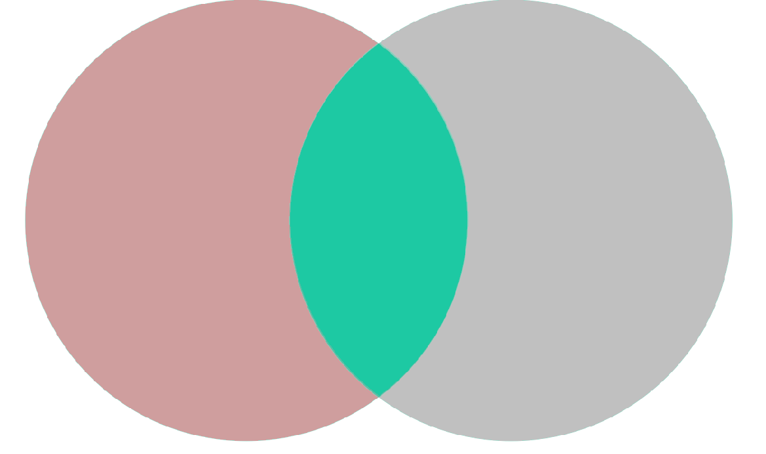
Academia:
Trusted Sources of
Clinical Information
Academic Detailing
Drug Industry:
Great Communicators
Notes:
21
21

Slide 22
Evidence-based, non-product-driven
research & communication
about real-world clinical decisions.
What We Need:

Slide 23
The Logic of Academic Detailing:
Medical (and pharmacy) school faculty have a solid grasp of the evidence about drug benefits and risks…
but we’re often terrible communicators.
Industry reps are superb communicators…
but their primary goal is to increase sales.
Can the content of the former be communicated to clinicians through a ‘delivery system’ based on the latter?

Slide 24
The Goal of Academic Detailing:
Closing the gap between:
Best Available Evidence
Actual Clinical Practice
Notes:
24

Slide 25
…So that clinical decisions are based only on the most current and accurate evidence about:
Efficacy
Cost-effectiveness
Safety
Notes:
25

Slide 26
NaRCAD History & Impact
Created with a grant from AHRQ in 2010, renewed in 2014
Helped establish and/or supported 34+ programs in 16+ states
We’ve trained 150+ Academic Detailers
We host the Annual International Academic Detailing Conference; this fall’s 2015 Conference will be our 3rd annual.

Slide 27
Evolution of Academic Detailing
Initial focus on medications
Adaptation to other clinical areas
Recognition of broader scope and definition

Slide 28
The Content of Academic Detailing
Well-trained clinicians (Pharm, RN, MD) visit clinicians in their offices and offer a service that provides non-commercial, evidence-based information about the comparative benefit, risk, and cost-effectiveness of treatments and tests used for common clinical problems.

Slide 29
The Method of Academic Detailing
It’s educational outreach.
Generally in the frontline clinician’s own office
Information is provided interactively, so the educator can:
Understand where the MD is coming from in terms of knowledge, attitudes, behavior
Modify the presentation appropriately
Keep the practitioner engaged
The visit ends with specific practice-change recommendations.
Over time, the relationship is strengthened, based on trust and usefulness.

Slide 30
What Academic Detailing is Not:
Memos or brochures (“the truth”) sent through the mail
Lectures delivered in the doctor’s office
About formulary compliance
About cost reduction, primarily
Merely an attempt to un-do industry marketing
(that’s why it’s not ‘counter-detailing’!)

Slide 31
Differing Scales of Academic Detailing Programs
Temporary Programs:
Specific issue over smaller timeframe
Redeployment of current resources
Longer Term Programs: (Limited Scale)
Redistribution of current resources
Multiple issues across multiple disease areas
Longer Term Programs: (Large Scale)
Dedicated resources on broad range of medical areas

Slide 32
Flexible Uses of Academic Detailing:
Improving Knowledge
Changing Treatment
Advancing Patient Education
Increasing Diagnosis & Screening
Expanding Use of Complementary Resources

Slide 33
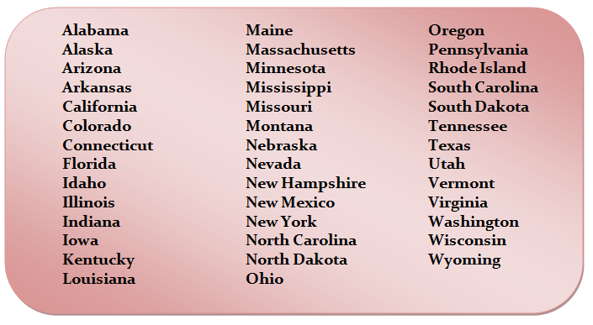
Clinical Education Programs in the U.S.
Notes:
33

Slide 34
Global Programs:
Australia
Canada
Netherlands
New Zealand
Norway
Portugal
Sweden
United Kingdom
Japan
(Partial List)

Slide 35
Academic Detailing Programs are Covering: [Partial List]
Nursing Home Care
Opioids
Cancer Screening
Child Wellness
Autism Screening
Falls Prevention
Diabetes Treatment
Smoking Cessation
Notes:
35

Slide 36
Academic Detailing in Practice
Brings EBM to clinicians in a way that is:
When clinicians see academic detailing as a service, they are primed to use the information to improve patient care and outcomes
Easy to understand and use
Addresses their needs and priorities
Helps them learn new information/skills

Slide 37
Contact Information:
NaRCAD
Division of Pharmacoepidemiology & Pharmacoeconomics Brigham and Women’s Hospital & Harvard Medical School 419 Boylston Street, Floor 6 | Boston, MA 02116 857.307.3801 | narcad@partners.org
www.narcad.org
Connect with us on social media:

